Slide 1
Hungry Panda
An IOD CapStone Project By: Benjamin

Slide 2
Table of contents
01
02
03
04
Product Description
Project Planning
Introduction
What’s Next
Industry
Purpose
Stakeholders
Architecture
User stories/flow
Wireframe design
Non-functional requirements
Trello Board
Testing
Implementation

Slide 3
01.
Introduction

Slide 4

Introduction
Industry
Food and Beverages
New restaurants popping up. Need to spend $$ on advertising to gain media presence
The more money you spent the more traction you get to your restaurant

Slide 5
Introduction
Purpose
A platform where foodies (people who live to eat) can freely post about their favourite dining spots and give their own reviews without being influenced by mainstream food medias
Not sure if a review is authentic or bias due to sponsorship
Pain point of foodies is paying for food that you had high anticipation for but end up getting disappointed.
Current players: LadyIronChef, HungryGoWhere, EatBook, google reviews, BURPLE

Slide 6
Introduction
Stakeholders
Average foodies who wants to put their food critic skills to the test, Restaurant owners, Actual food reviewers (non sponsored)
A place where they can express themselves freely through food among people with the same passion for food
Stakeholders can expect a platform filled with authentic reviews, lessen your chances of having food disappointments

Slide 7
02.
Product Description

Slide 8
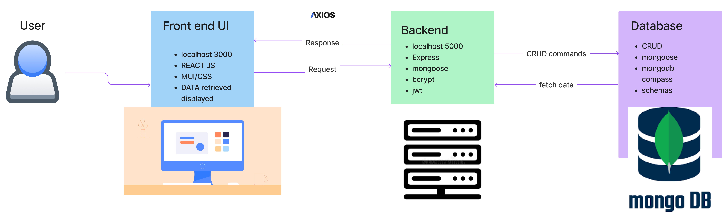
Product Description
Architecture Diagram

Slide 9
Product Description
Architecture Diagram
# | User Story Title | Description | Priority | Additional notes
1 | Finding places to eat | As an user I want to search for places to eat | 3 | Achieved
2 | Personalisation | As an user I would want to have my own page with my details | 4 | Achieved
3 | Saving posts | As an user I would like to save reviews that I would like to visit in the future | 5 | Achieved
4 | Sharing reviews | I would like to be able to share my own personal reviews | 5 | Achieved
5 | Reservation | I would like to be able to contact the restaurant to make reservations through the website | 3 | Future implementation
6 | Location search | I would like to find places that are recently reviewed within my area | 4 | Future implementation

Slide 10
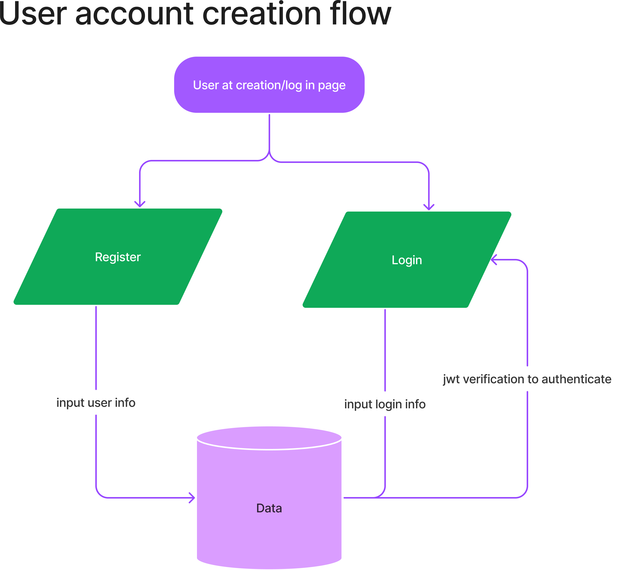
Product Description
Userflow

Slide 11
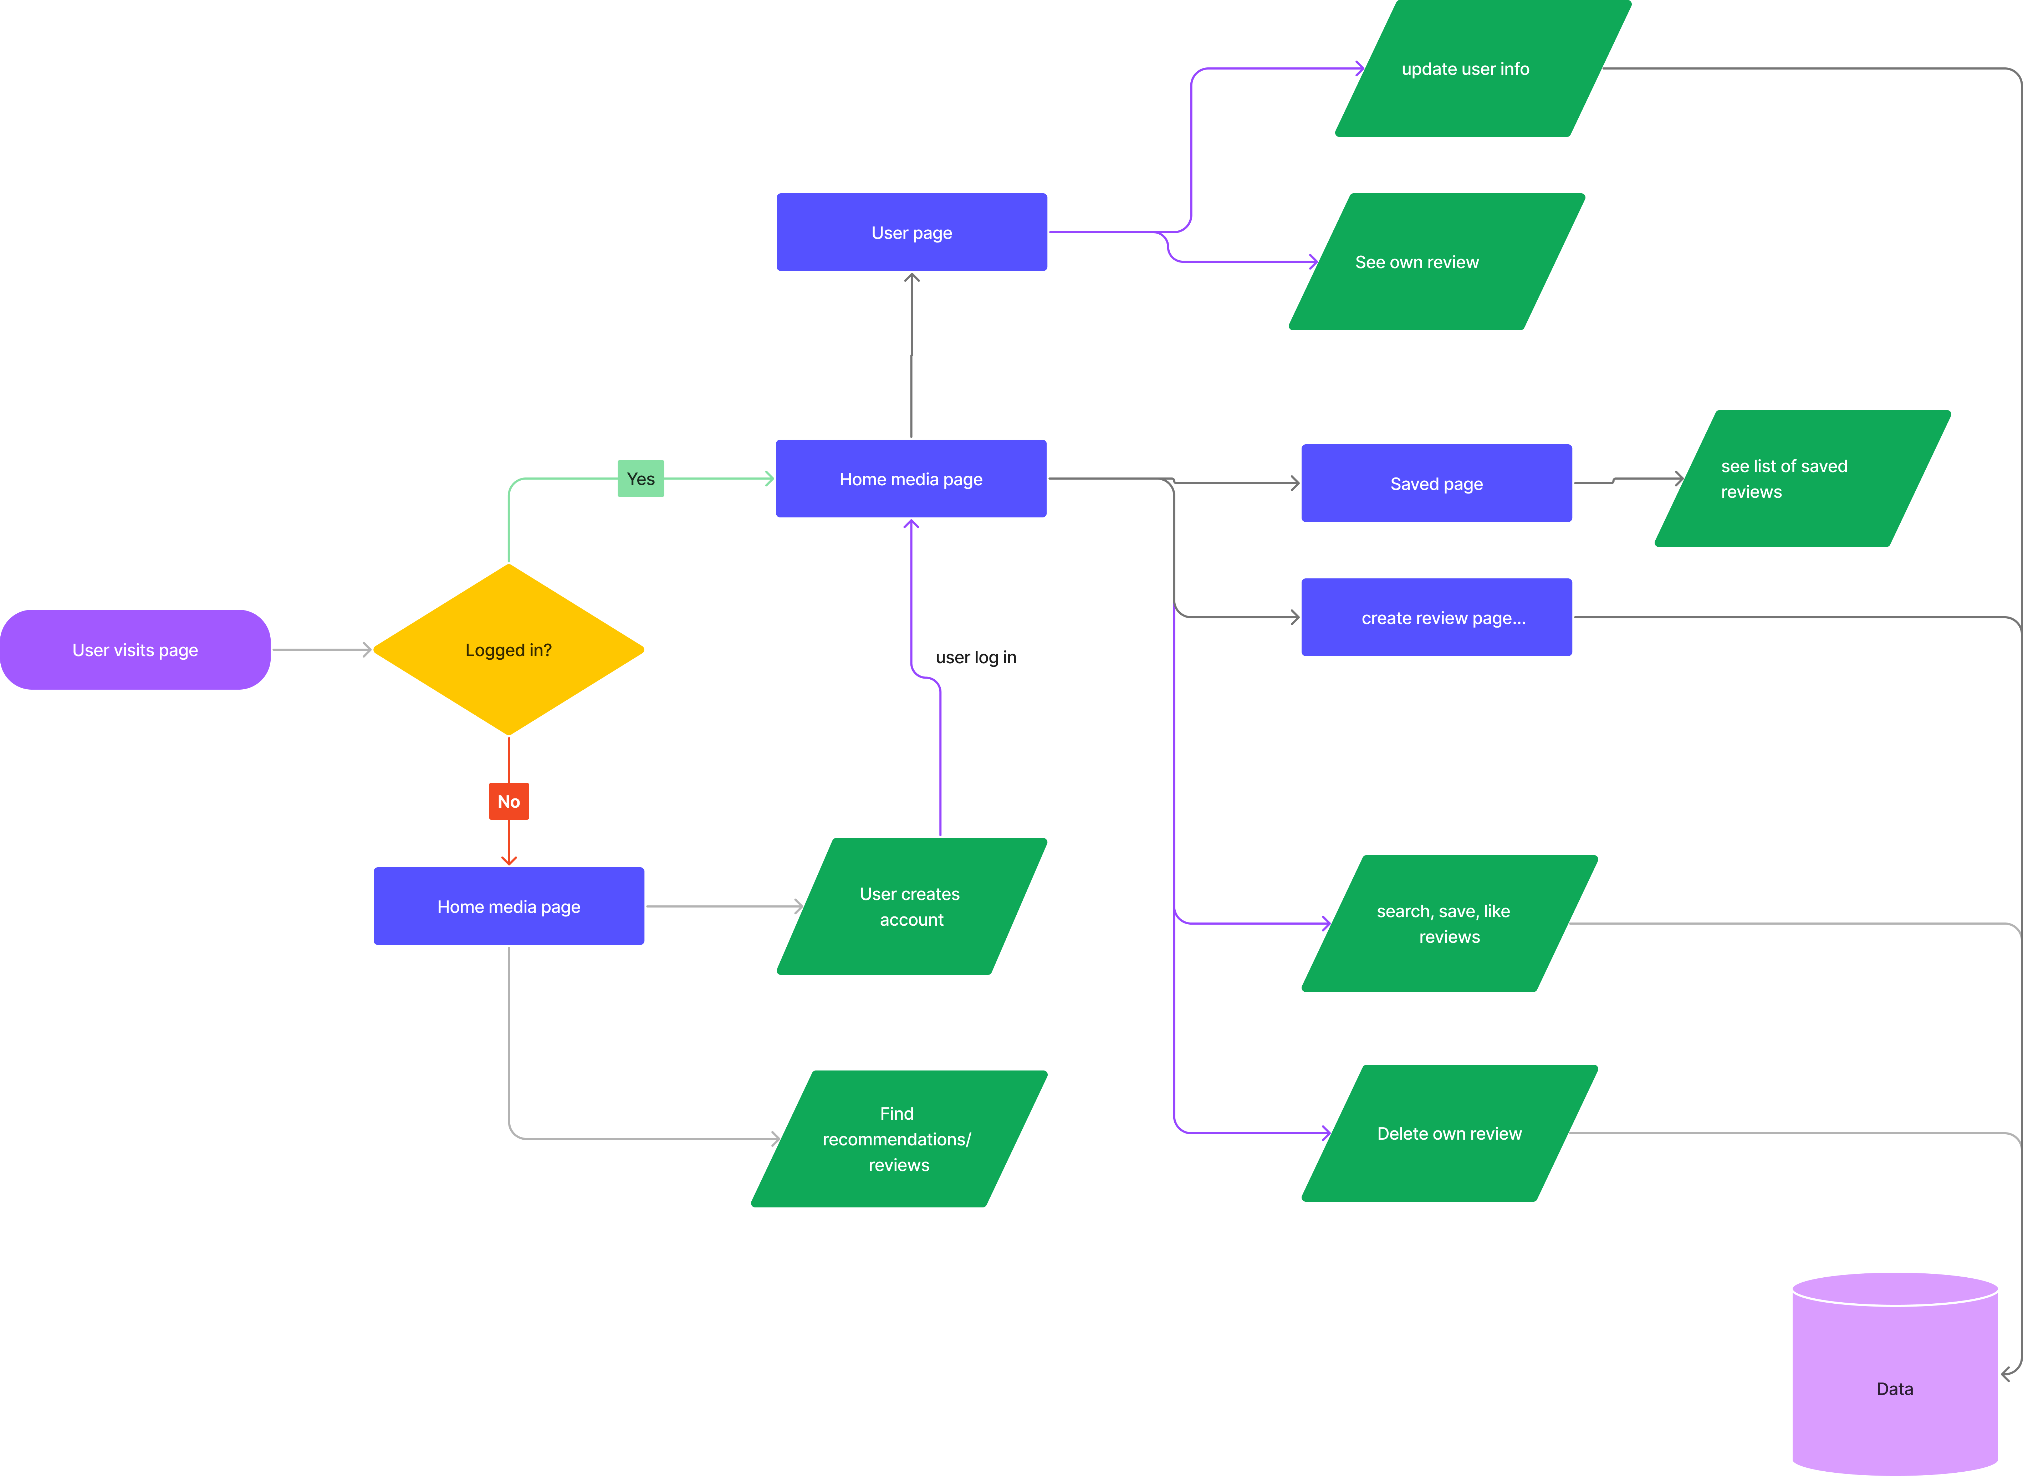
Product Description
Userflow
Main web page

Slide 12
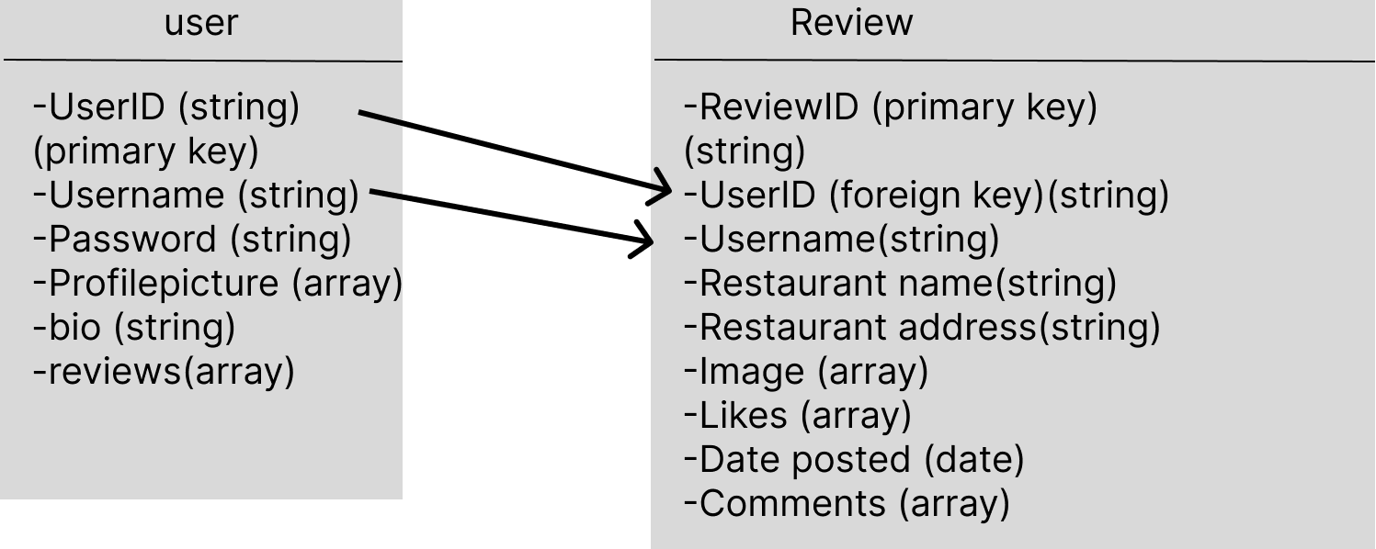
Product Description
Data physical model

Slide 13
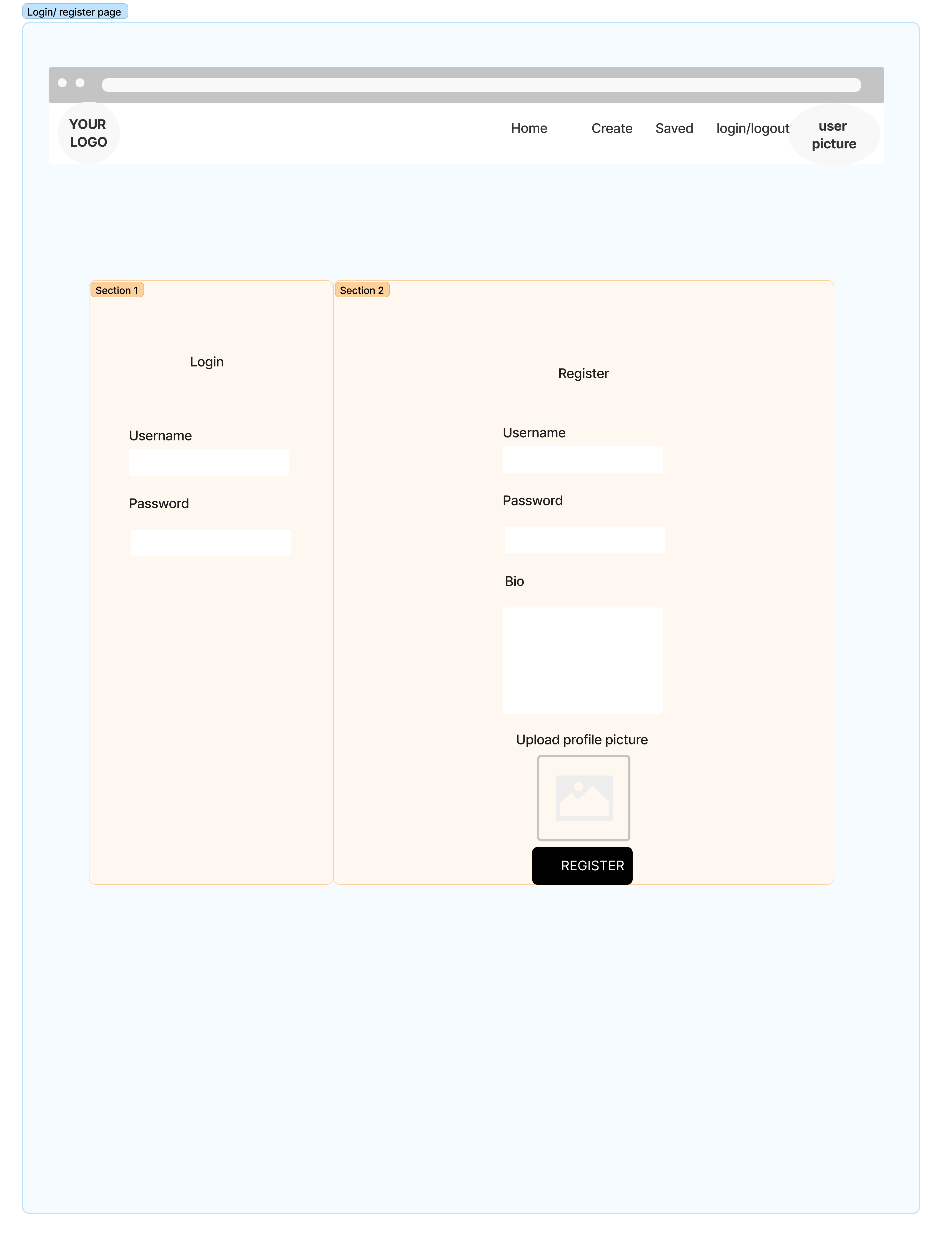

Wireframe
Login/ register page

Slide 14
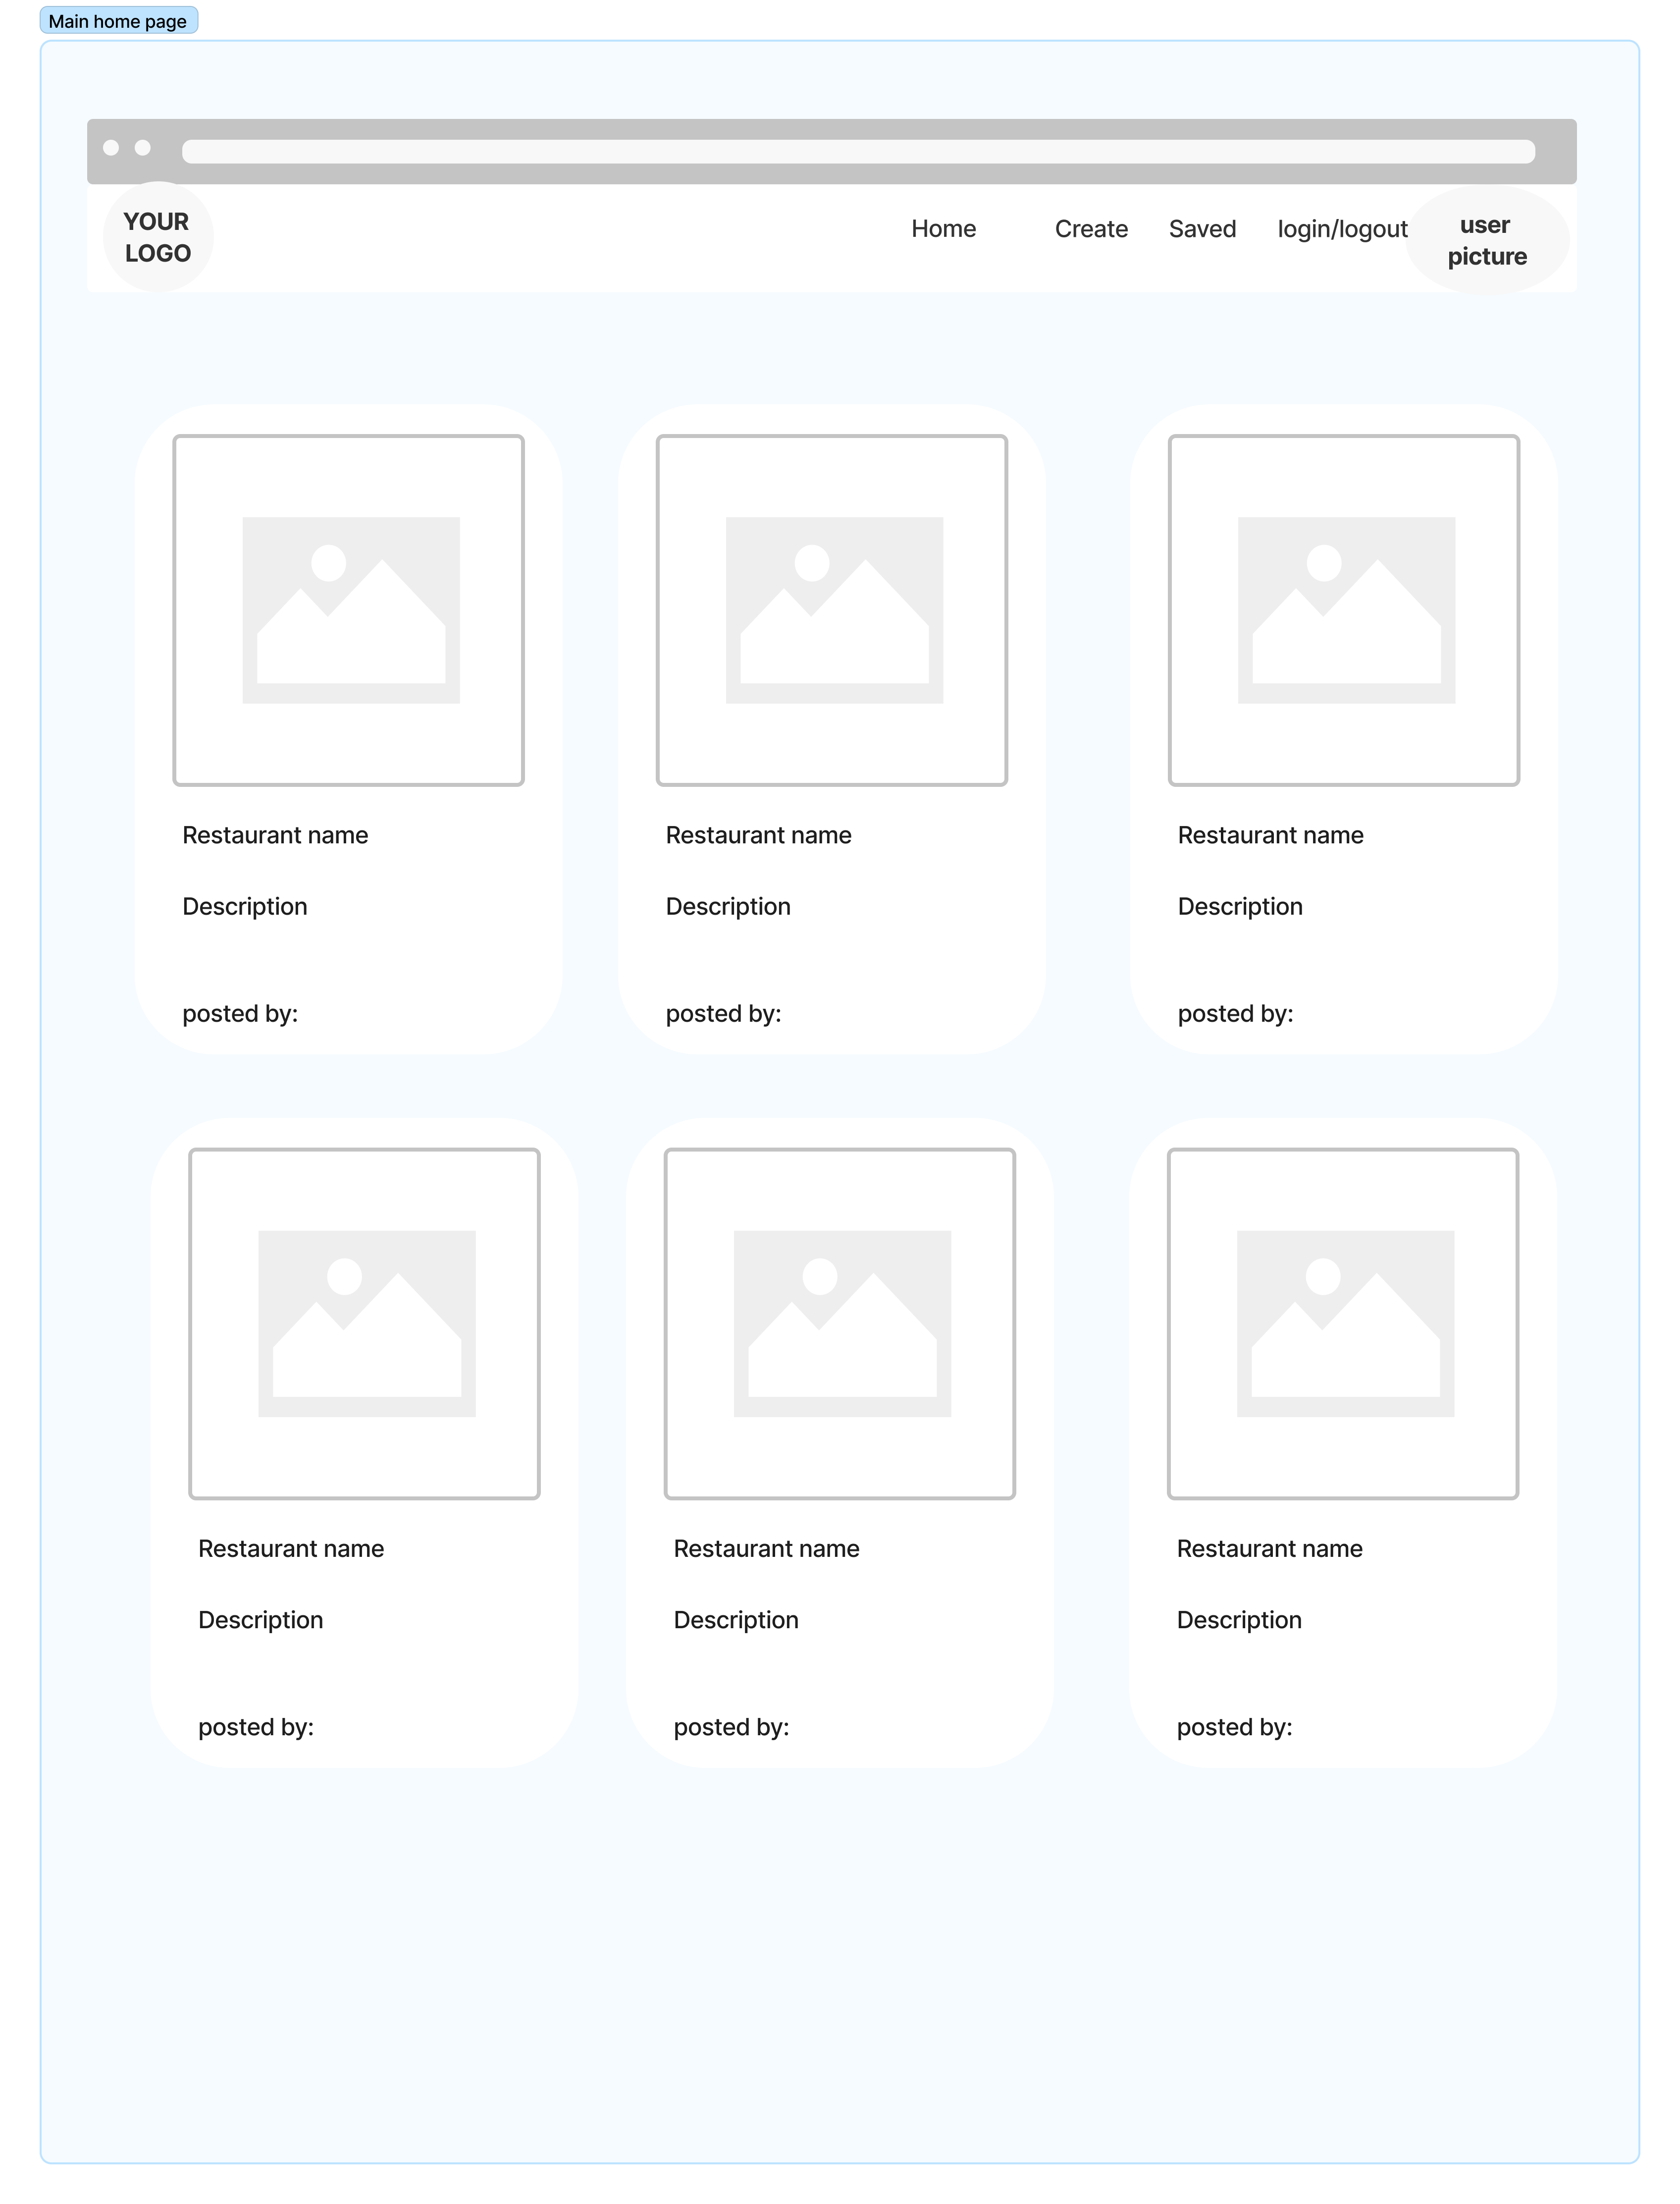
Wireframe
Main page

Slide 15
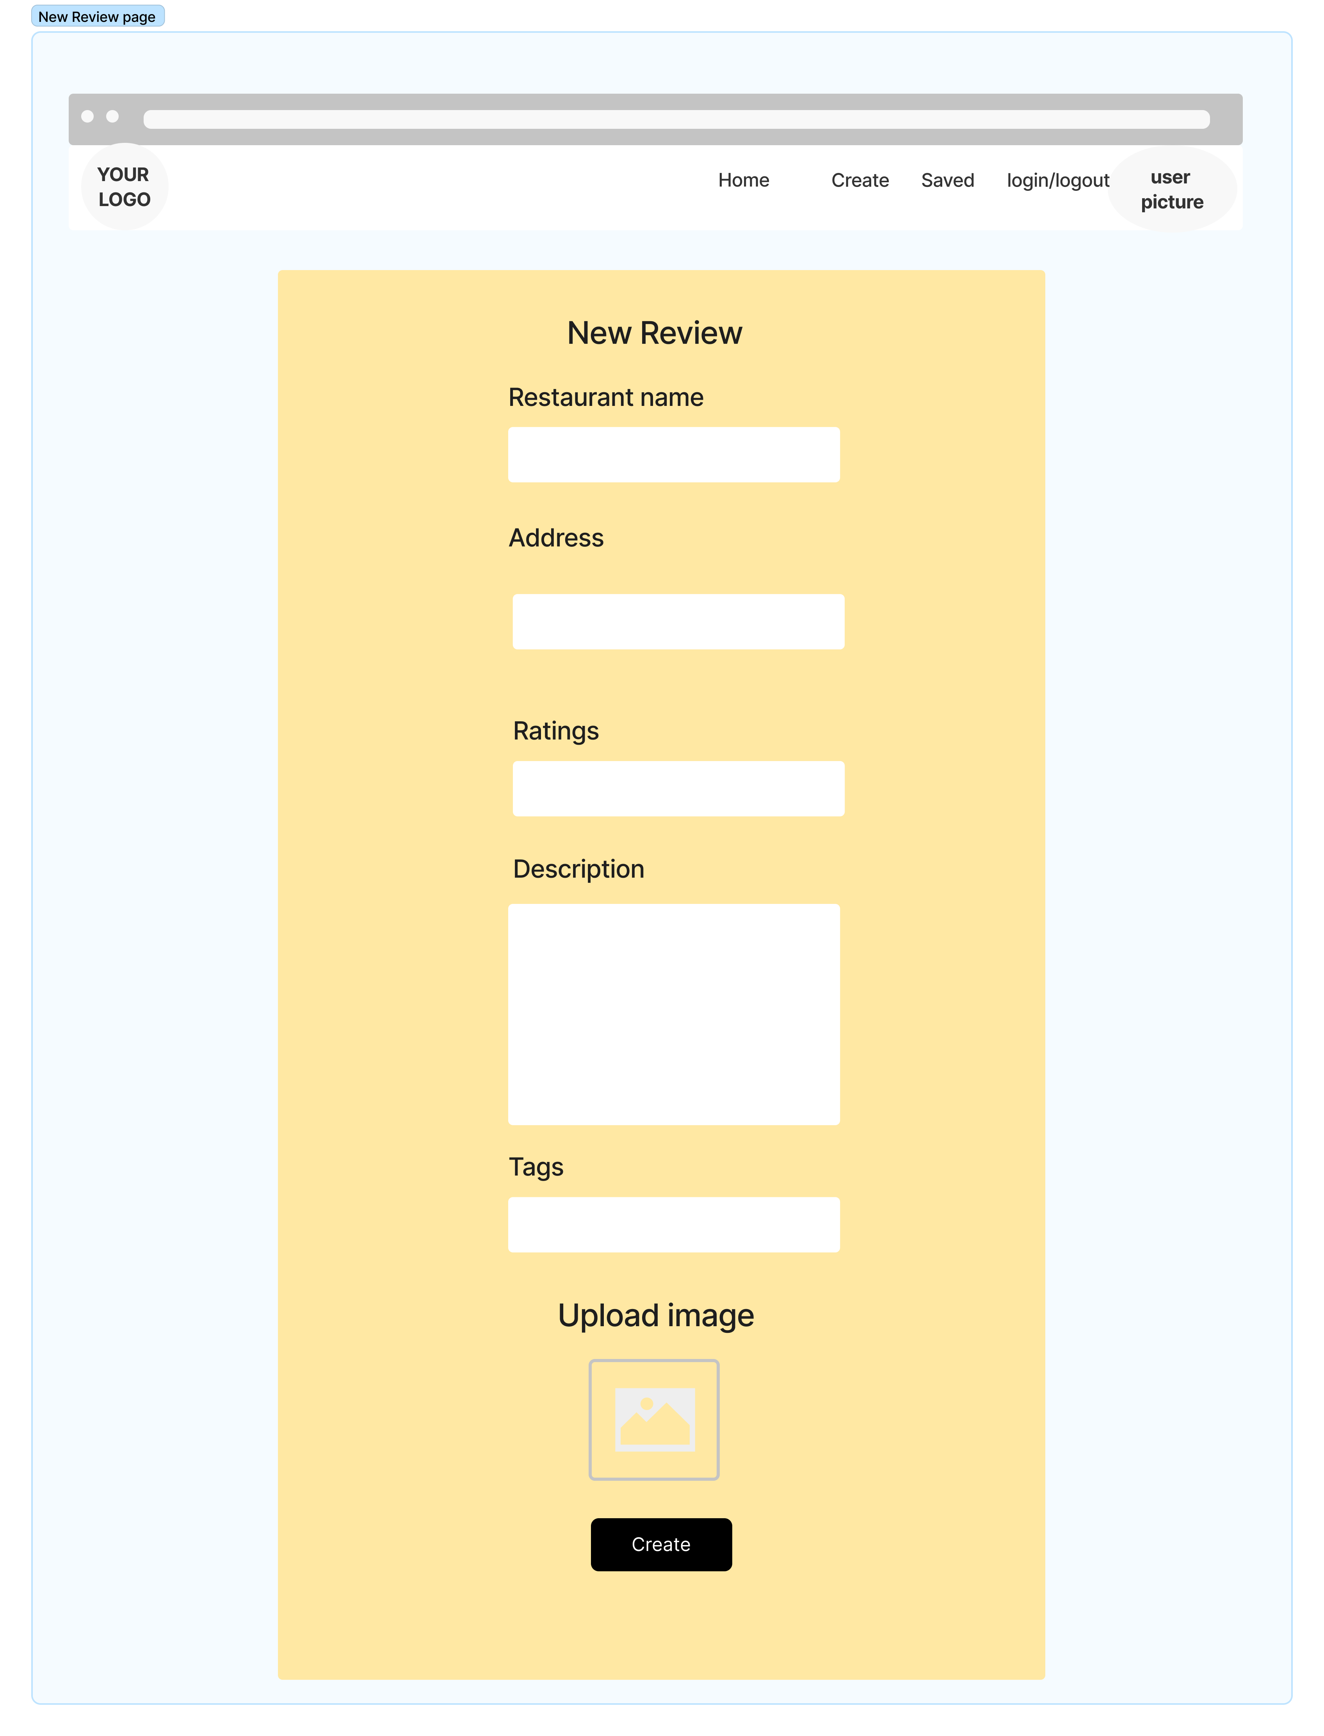
Wireframe
New Review page

Slide 16
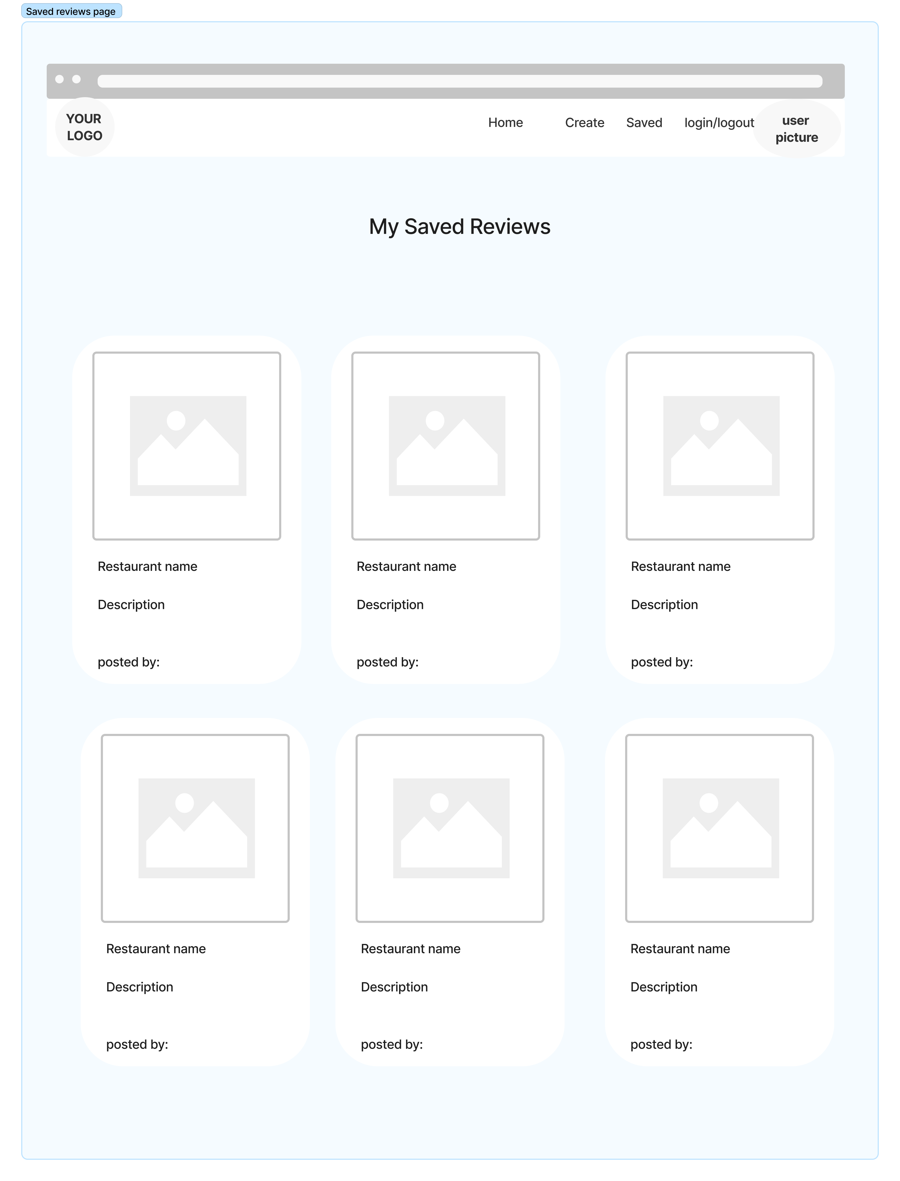
Wireframe
Saved Review page

Slide 17
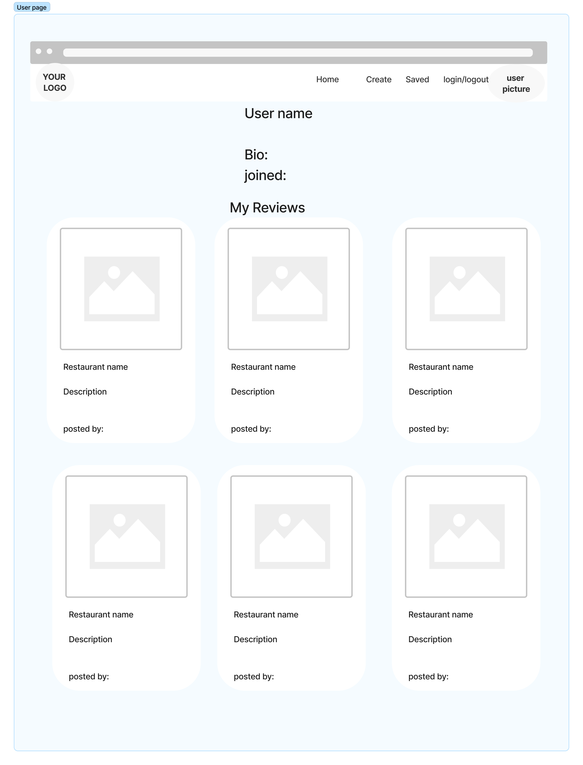
Wireframe
User Profile page

Slide 18
Introduction
NFR
User password has to be encrypted (bcrypt)
User has to be verified to access some functions (edit, delete) (jsonwebtoken)
Creating environment variables to keep password hidden

Slide 19
03.
Project Planning

Slide 20
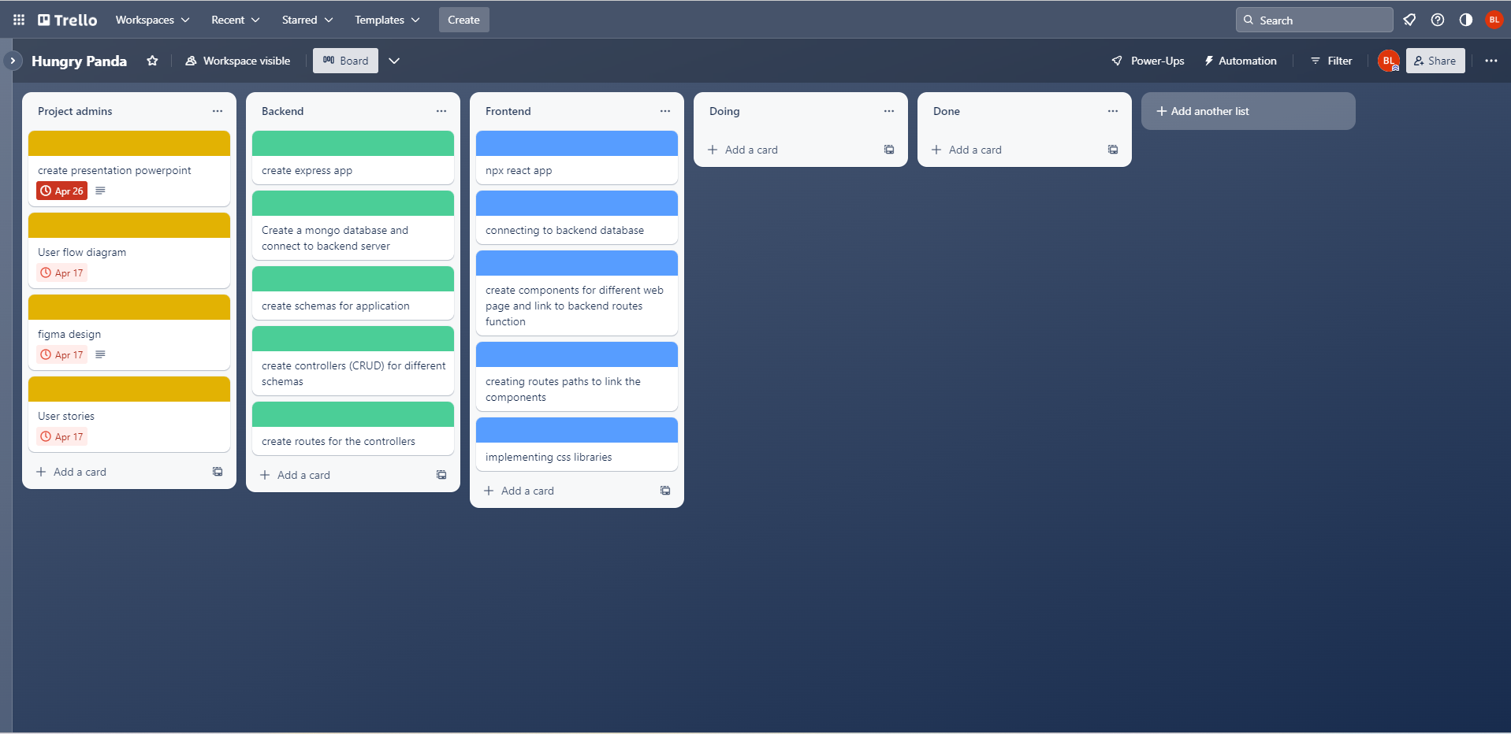
Project Planning
TrelloBoard

Slide 21
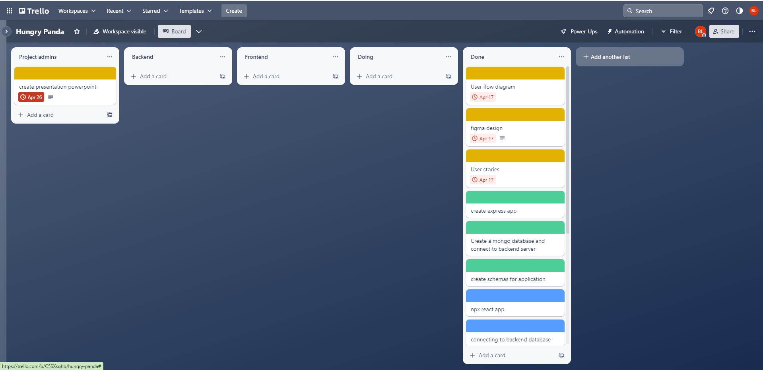
Project Planning
TrelloBoard

Slide 22
Project Planning
Testing
Front end user interface is tested manually through chrome
Backend were tested using postman api
Common bugs: endpoint errors, Axios error, pushing data to DB

Slide 23
Project Planning
Implementation
Frontend can be hosted via Netlify
Backend will be deployed to AWS EC2
Allows the server to run 24.7

Slide 24
Project Planning
End to end solution
Met most of the user stories objective
More features to add to improve the server functions

Slide 25









Resources used
Backend
Frontend
Github repo link: https://github.com/benjaminLeongSK/IODdemo/tree/main/Capstone

Slide 26
Thankyou
Q&A

